Slide 1
Occlusion Detection
Abid, Jasvir, & Alex <3

Slide 2
How can we see things that are hidden by something else?

Slide 3
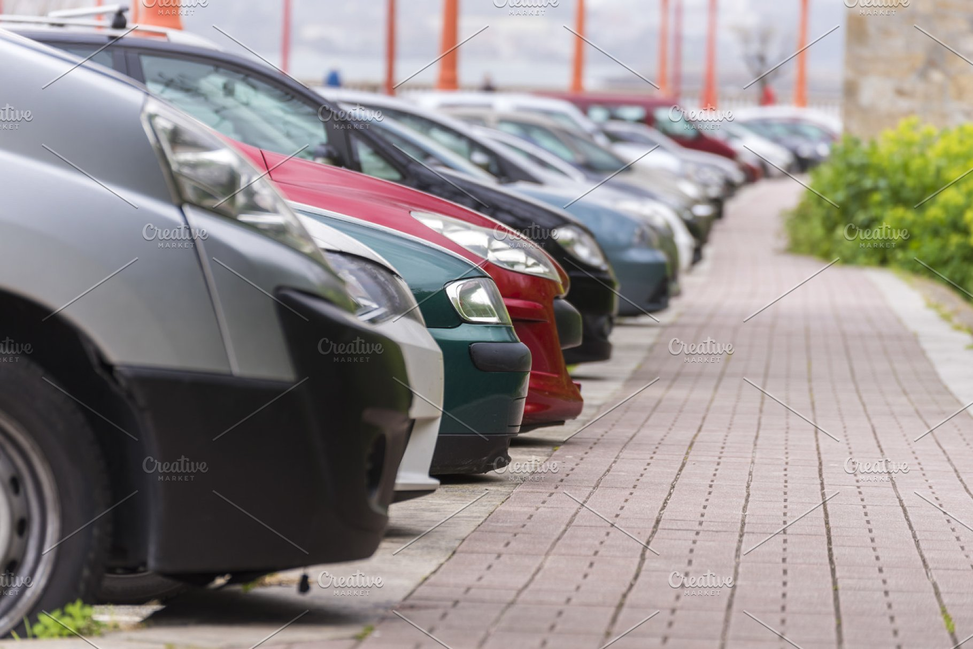
We need a hero

Slide 4
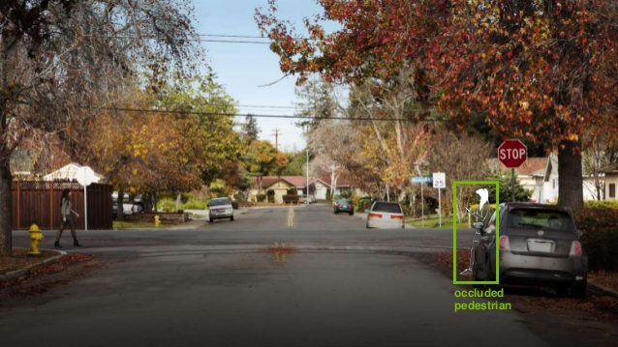
Occlusion Detection!
Detecting highly occluded (mostly hidden) objects in computer vision
Consider a pedestrian occluded by a car parked in front of us.

Slide 5
State of the art
Disadvantages
YOLO + NMS
You Only Look Once
Non-Maximal Suppression
NMS + ODE
Non-Maximal Suppression
Object Density Estimator
Learning NMS end-to-end
Bad detection performance with heavy occlusion.
This requires much higher computational load.
Adding an additional neural net for end-to-end learning, no longer real-time.

Slide 6
Visibility Guided NMS
Also known as vg-NMS

Slide 7
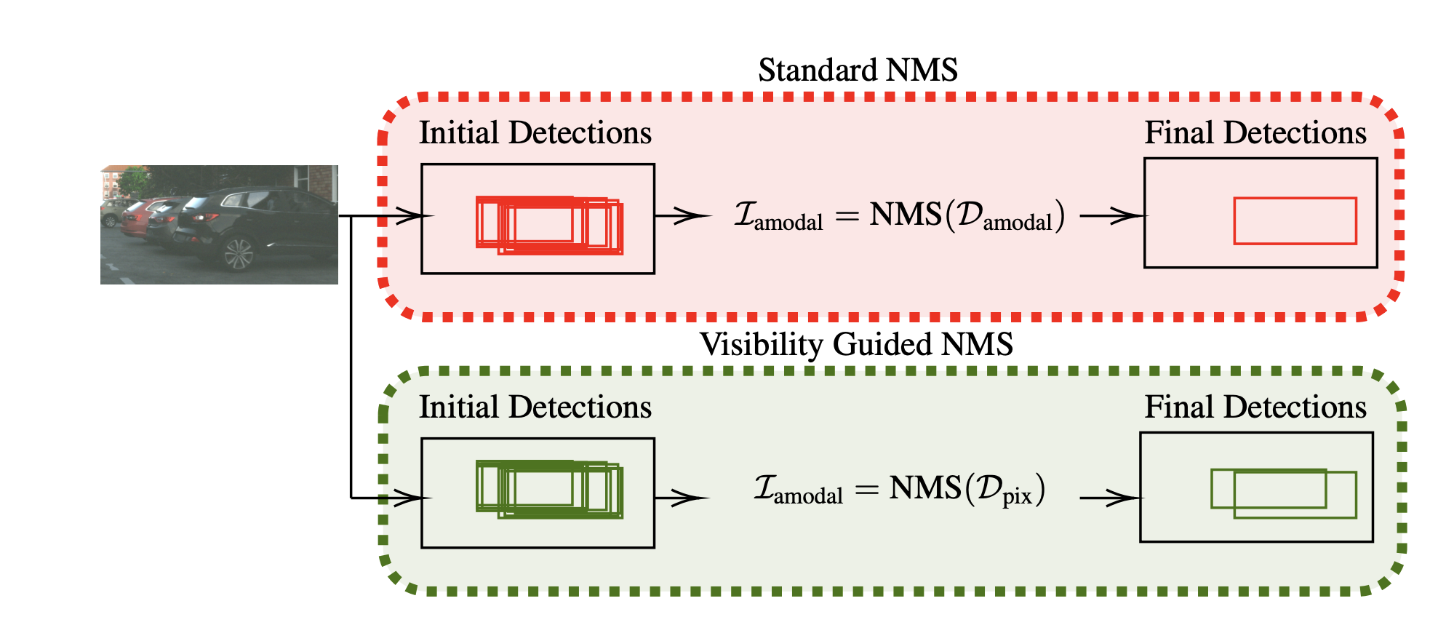

Slide 8
Testing
We plan on using the KITTI and Synscapes testing image databases to run our system over, and then judging the results on a case-by-case basis.
References:
Visibility Guided NMS: Efficient Boosting of Amodal Object Detection in Crowded Traffic Scenes - Gahlert, Hanselmann, Franke, & Denzler.
Adaptive NMS: Refining Pedestrian Detection in a Crowd - Liu, Huang, & Wang.
Learning Non-Maximum Suppression - Hosand, Benenson, & Schiele.

